Slide 1
API Underprotection
May 6th, 2018 - John Spann

Slide 2
Credit where credit’s due
Presentation from OWASP AppSec California 2018 conference
Skip Hovsmith
Principal Engineer and VP Americas, CriticalBlue
http://sched.co/CuS2
https://www.approov.io/blog/practical-api-protection-walkthrough-part-1.html

Slide 3
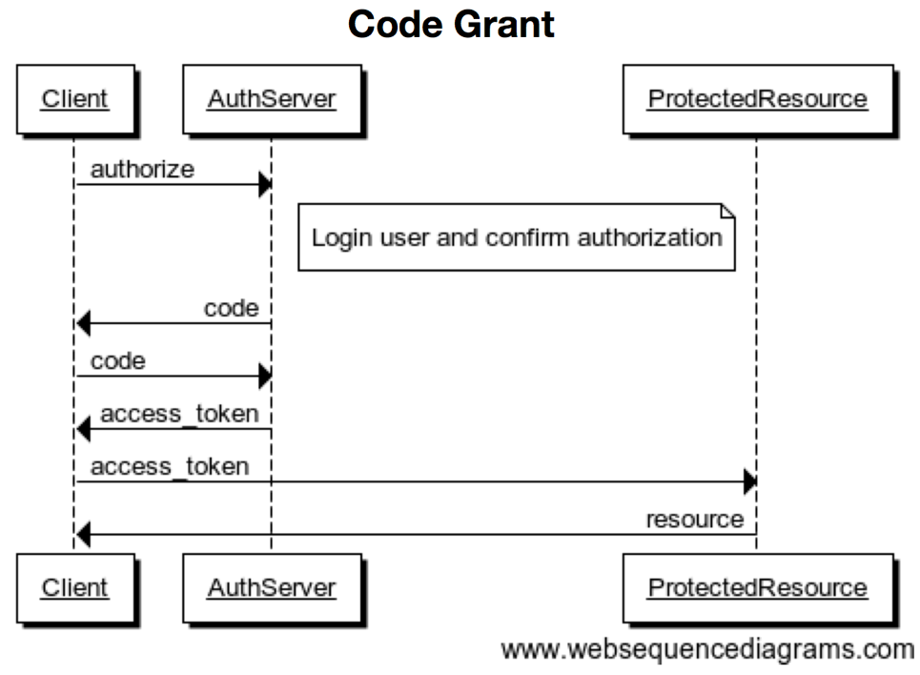
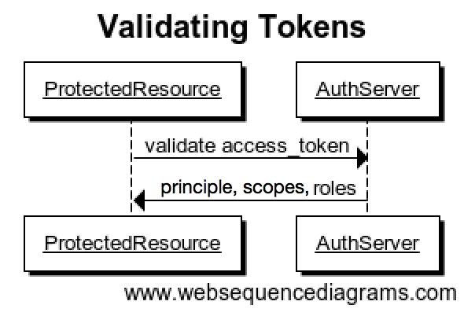
OAuth Workflows
Notes:
Added Token Validation based on Meetup Questions

Slide 4
OAuth Basics
Leverage Scopes to restrict access token validity beyond desired usage
Access Codes (Code Grant Flow) & Refresh Tokens must be one-time use
Implicit Grant Redirect URIs should be explicit whitelists, not regex/wildcard matches
Short lived access tokens
Notes:
Added Slide after Meetup Discussion

Slide 5
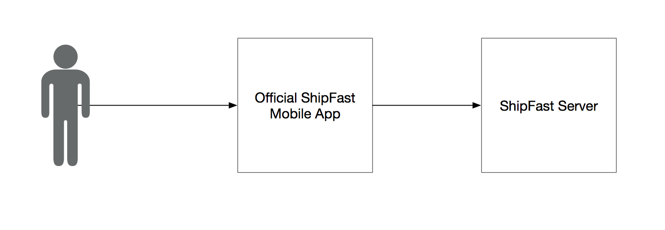
The Project Setup

Slide 7
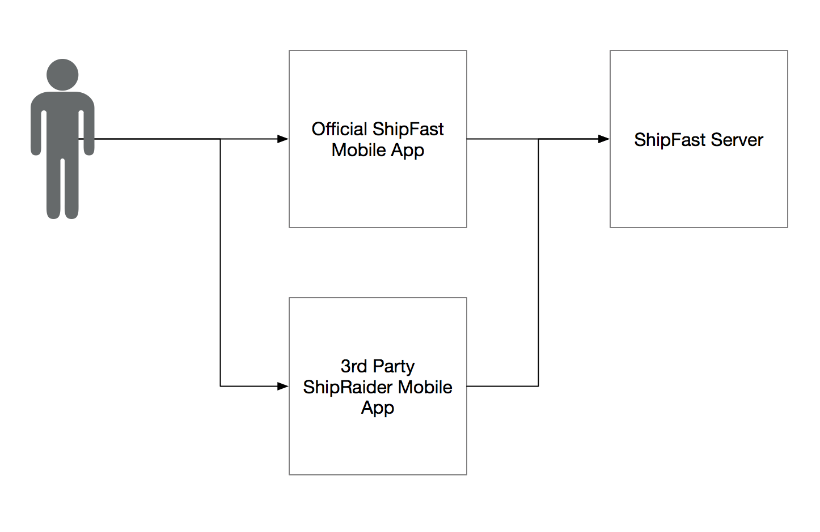
The Abuse

Slide 9
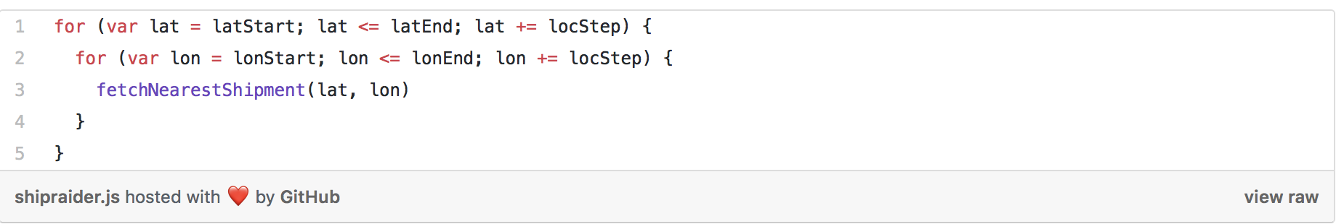

Slide 10
Defense Options
Rate Limits
Behavior mitigation (e.g. fast travel consideration)
Certificate Pinning
Proof Key for Code Exchange (PKCE, pronounced pixie - RFC7636)
App Signature Verification

Slide 11
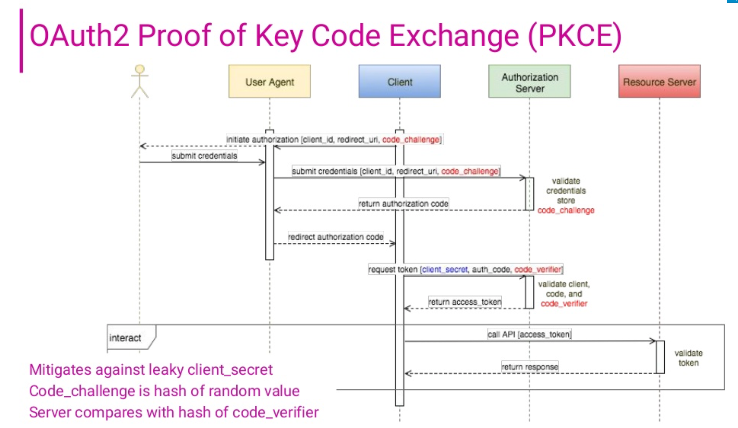
Source: Slide 63
https://www.slideshare.net/LF_APIStrat/lfapistrat17owasps-latest-category-api-underprotection

